Slide 1



COVID-19… India
Proposal to make survival easier in Country wide Lockdown.
Stay Home, Stay Safe.
Neeraj Bhardwaj | C P Sharma (#panditcpsharma)| Mangal Shukla (#mds4world)

Slide 2
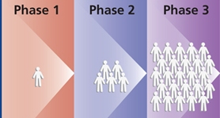

COVID-19
Corona Spread Phases
Threat to Existence of Humankind

Slide 3

COVID-19
Country wide LOCKDOWN

Slide 4
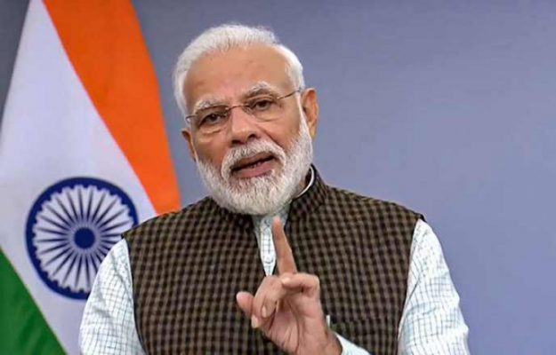
PM MODI:
21 DAYS
STAY HOME STAY SAFE
COVID-19

Slide 5
Stay Home, Stay Safe
What we
need?
COVID-19

Slide 6
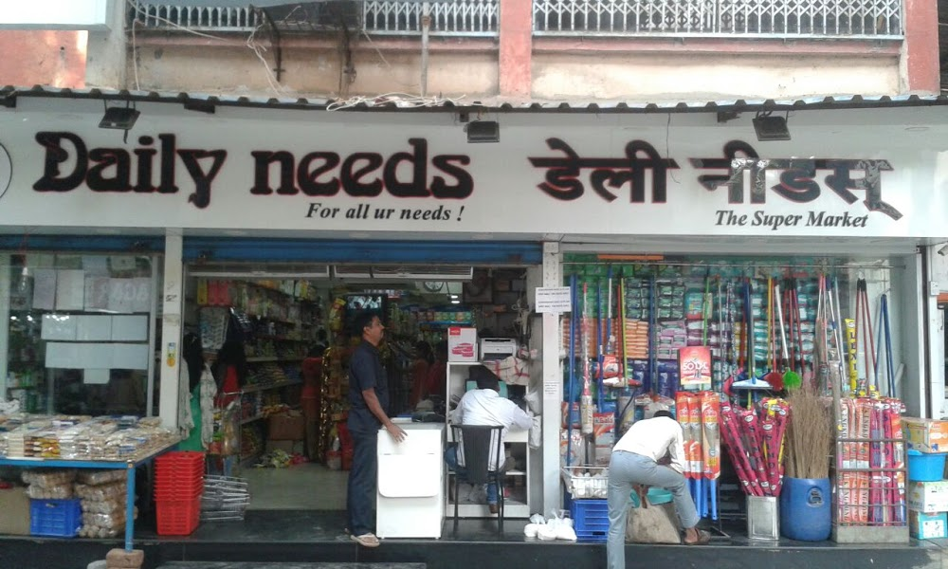

To Stay Home, We Need:
COVID-19

Slide 7
At Home, Our Needs Fulfilled By:
Generally people don’t store items in bulk, they order as they needed from other local stores or online stores (Amazon, Flipkart, Big Basket etc.)
Local Shops
Local Market
Super Market
Daily Needs / Medicines
Online Orders
Delivery Boy
COVID-19

Slide 8
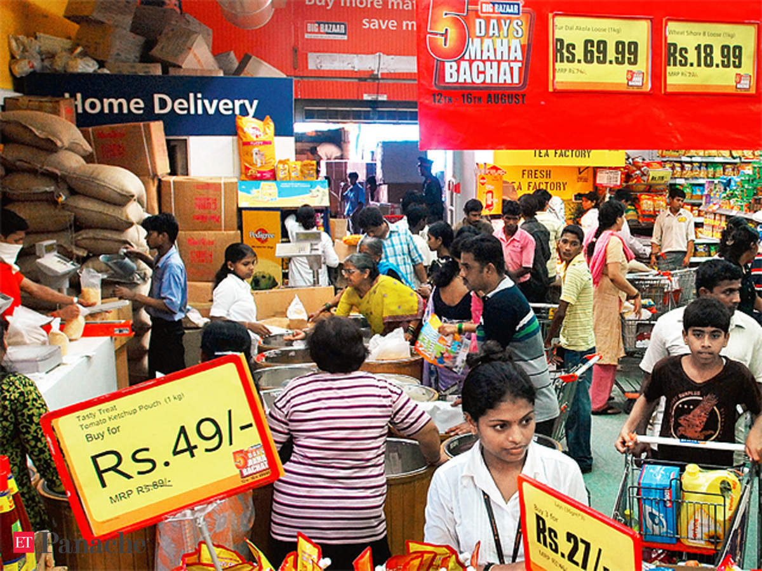
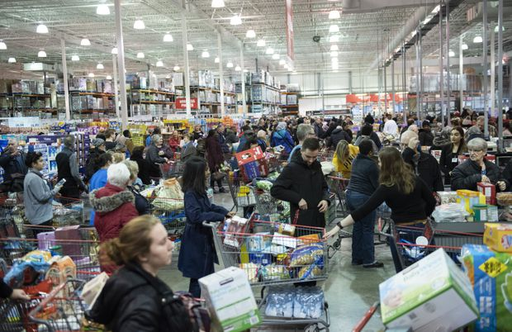

Infection prone Local Market -
Packet / Item could be infected
While Making Cash Payments
To Maintain Minimum Distance
COVID-19
Community Transmission

Slide 9
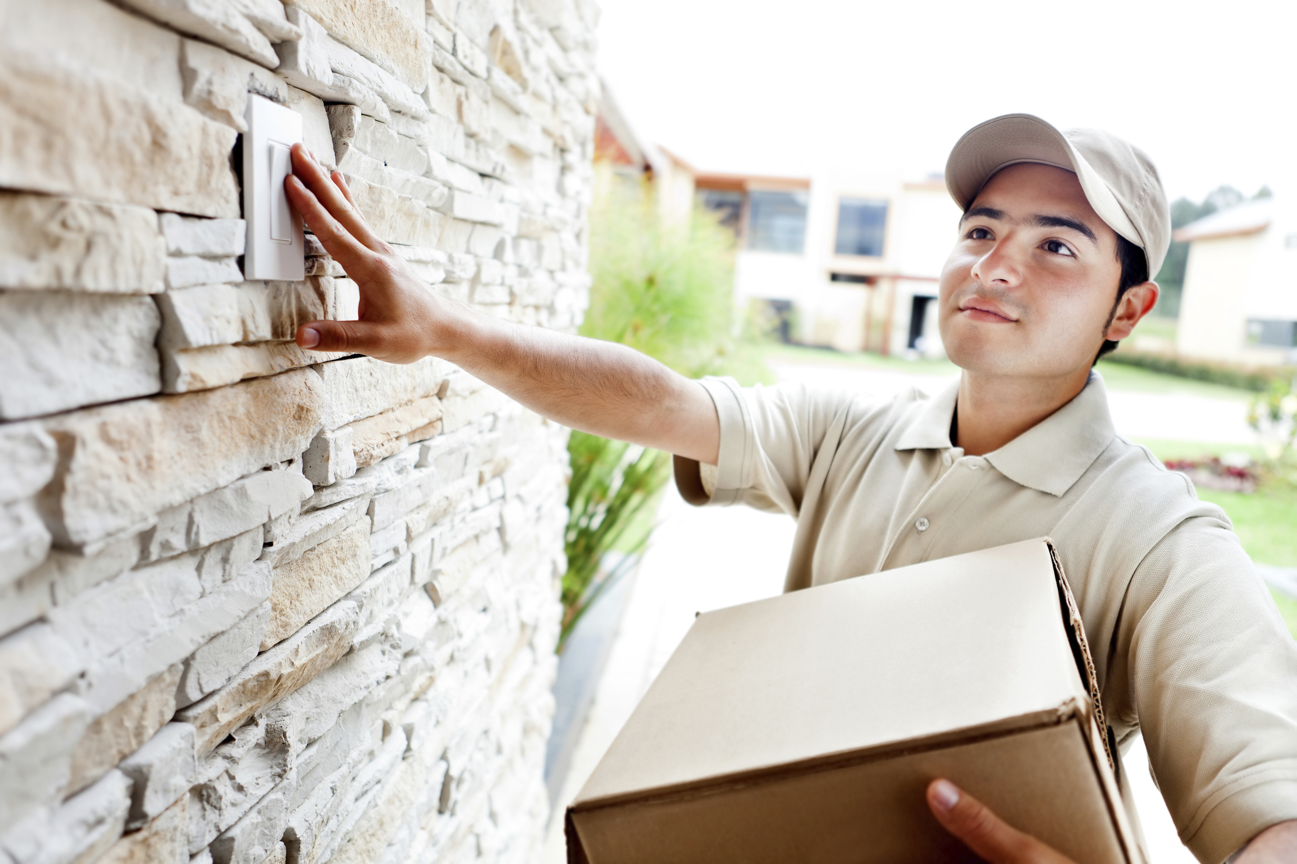
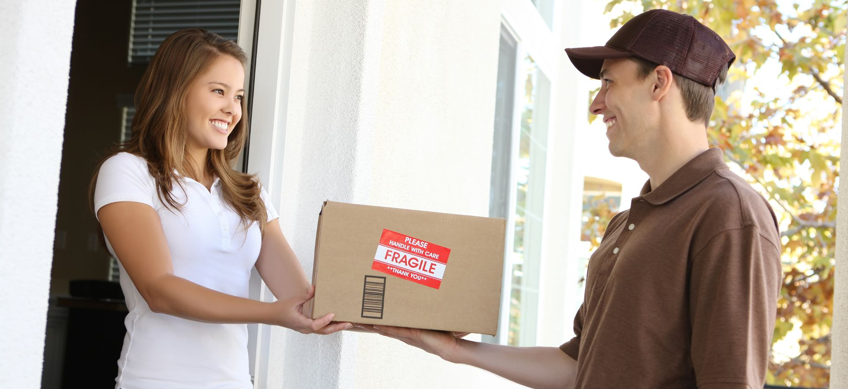

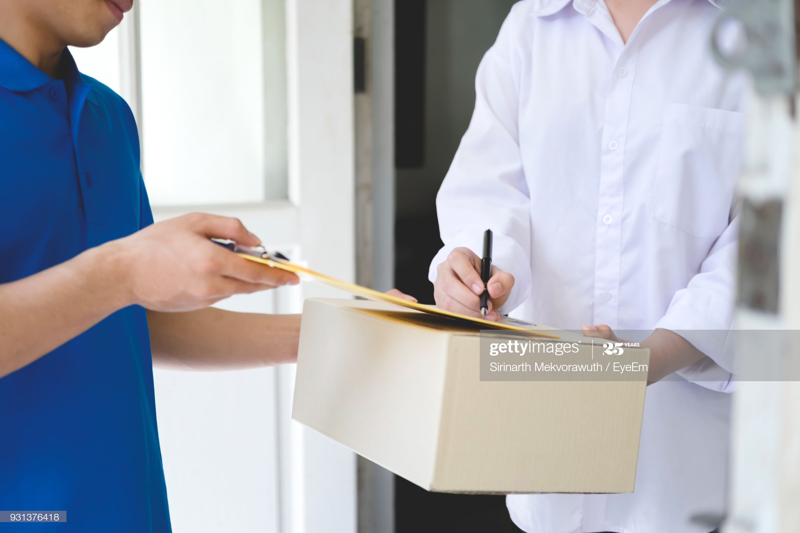
Online Orders: Door to door Infection prone delivery process
While Receiving Deliveries Only
While Giving Receiving
While Ringing Bell
COVID-19
Community Transmission

Slide 10
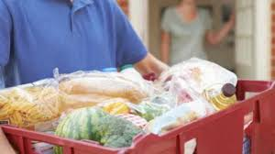
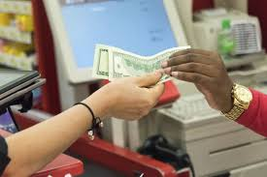
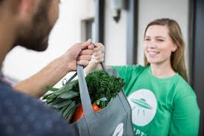
Stay Home safe, Avoid Fomites -
Fomites are Objects or materials which are likely to carry infection, such as News paper, Milk Packets, Delivery Parcels, Currency Bills etc (Community Transmission).
COVID-19
Community Transmission

Slide 11



Community Transmission
COVID-19
To CORONA

Slide 12

Even in lockdown stage, if people are going to local market, they are exposed to get infected.
The better approach is to go for online orders, follow Delivery Without Contact model, receive Sanitized Packages and Stay safe.
COVID-19
Community Transmission

Slide 13
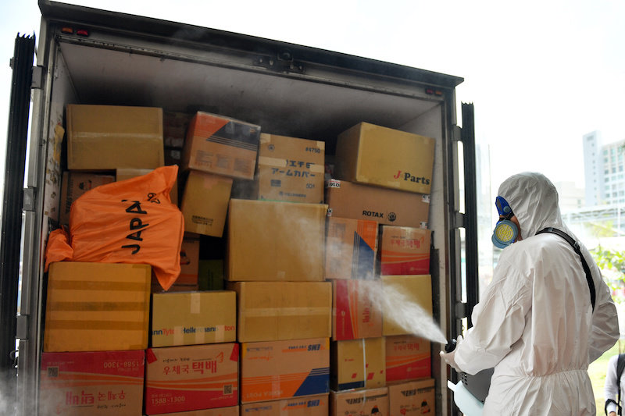
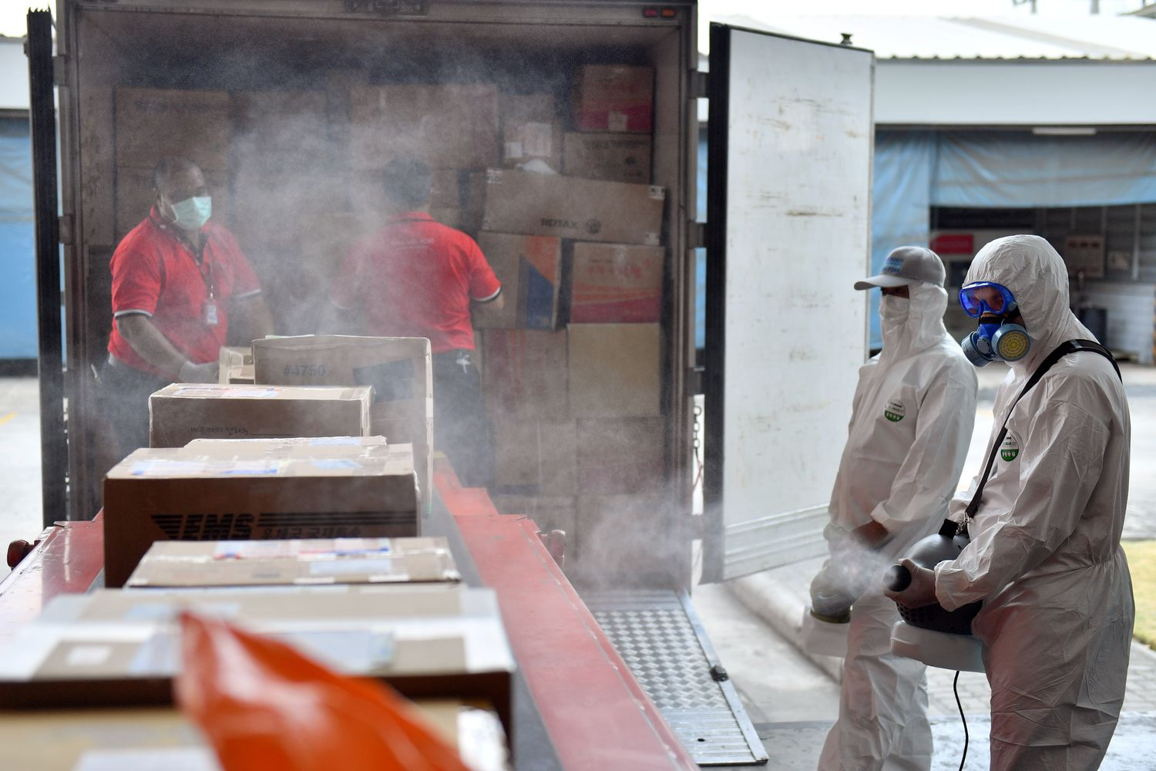
Specially trained delivery team should perform sanitization on package.
COVID-19
Community Transmission

Slide 14
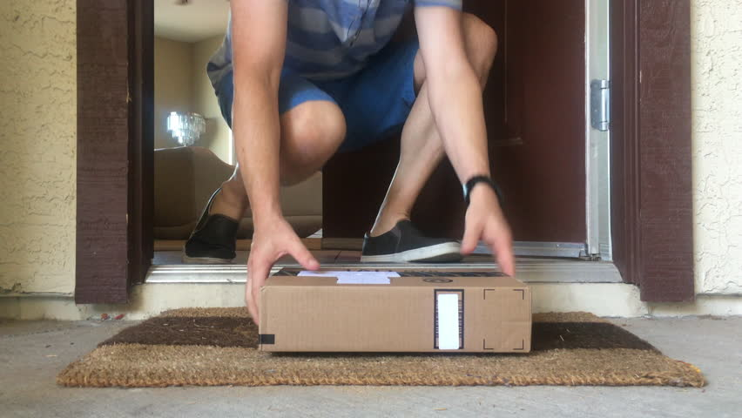
Delivery Without Contact to avoid further chaining.
Deliver Infection/fomites free packages.
COVID-19
Community Transmission

Slide 15
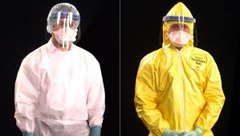
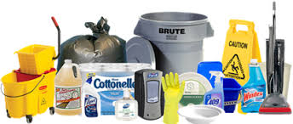
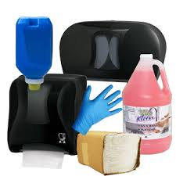
Delivery team to be equipped with entire safety kit i.e. Safety Gown, Gloves, Mask, Sanitization supplies etc.
COVID-19
Community Transmission

Slide 16





All “home delivery” teams across companies collectively( i.e. Amazon, Flipkart, BigBasket, Grofers etc.) should get trained, to adhere with WHO guidelines.
COVID-19
Community Transmission

Slide 17

COVID-19
Delivery: Fomites / Infection Free
Safe
Package
Community Transmission

Slide 18
COVID-19
Thank You!
Stay Home, Stay Safe
Neeraj Bhardwaj
C P Sharma (#panditcpsharma)
Mangal Shukla (#mds4world)
Inspired@AA
Disclaimer : All images are taken from Google
Community Transmission

